Slide 1
Coursera Capstone Project
for IBM Professional Certification in Data Science
“The Battle of the Neighborhoods”
Analysis of preferred restaurant opportunities in Dubai
By: Aayush Dua

Slide 2
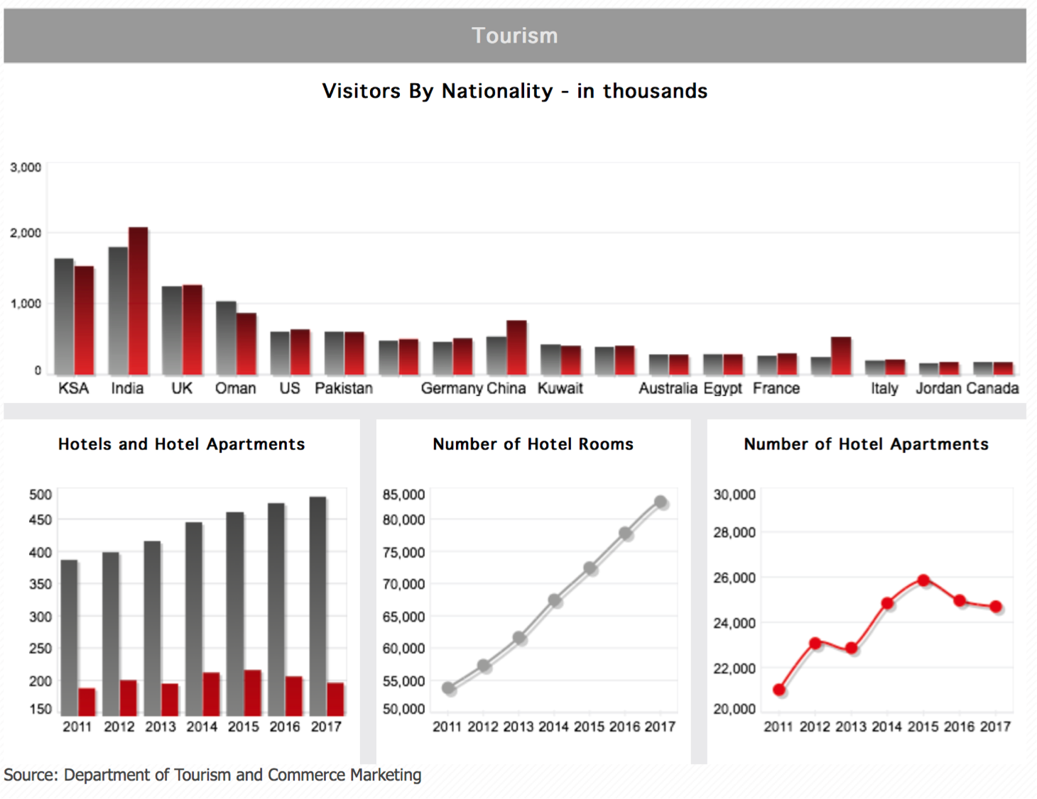
Problem statement
Due to its central geographic location and generally welcoming climate, Dubai is known for its international atmosphere. It is home to close to 2.5 Million expatriates who make up 90% of the total population and it hosts close to 15 Million visitors per year.
Question: if we were to consider an investment opportunity to open a restaurant, where would be the best place to do it?
Elements to consider:
Average rents by neighborhood
Ratio of Hotels to Restaurants
Proximity to ‘high rent’ neighborhoods
https://www.dsc.gov.ae/en-us/Pages/Tourism.aspx

Slide 3
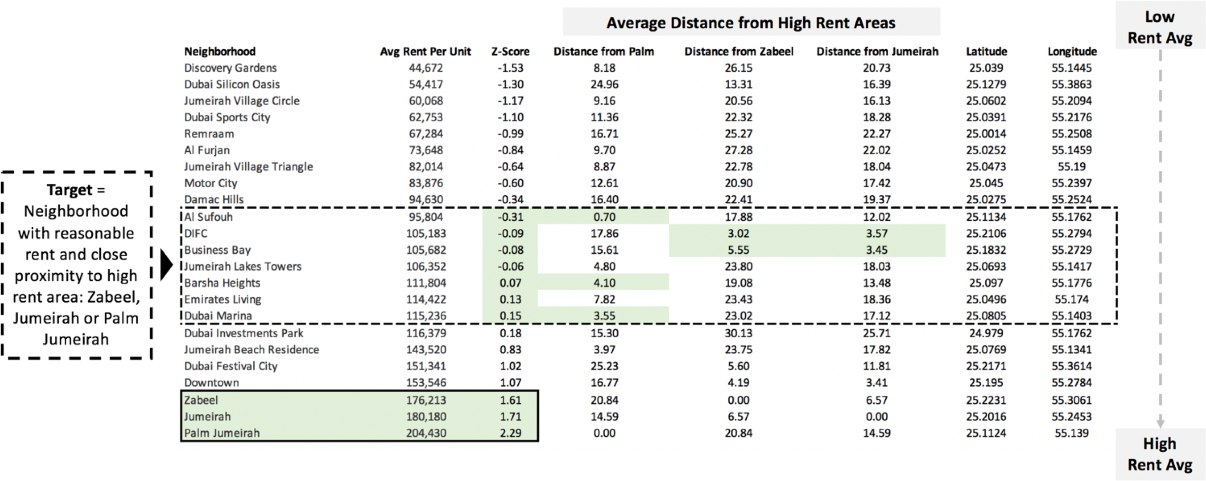
Preliminary Analysis:
Average rent by neighborhood and location

Slide 4
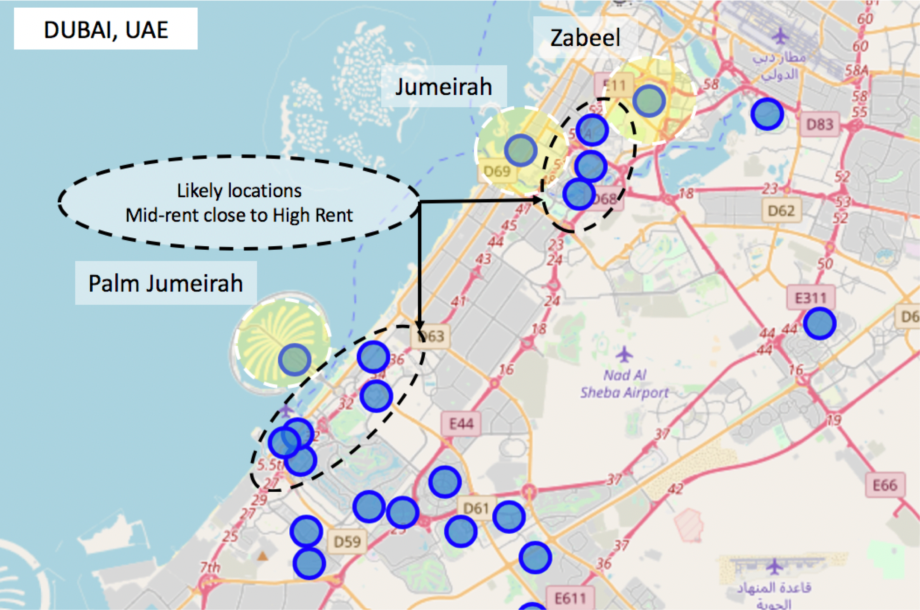
Initial Mapping of Neighborhoods
Focus on ‘mid-rent’ centers
in proximity to ‘high-rent’ centers
Al Sufouh
Barsha Heights
Business Bay
DIFC
Dubai Marina
Jumeirah Lake Towers

Slide 5
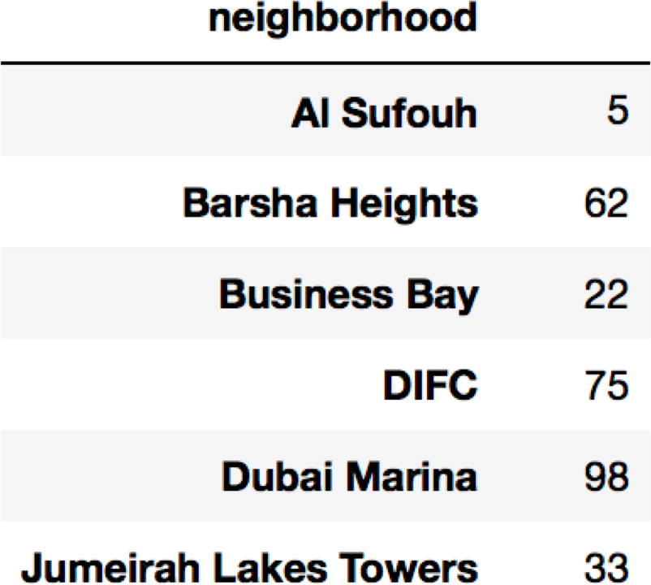
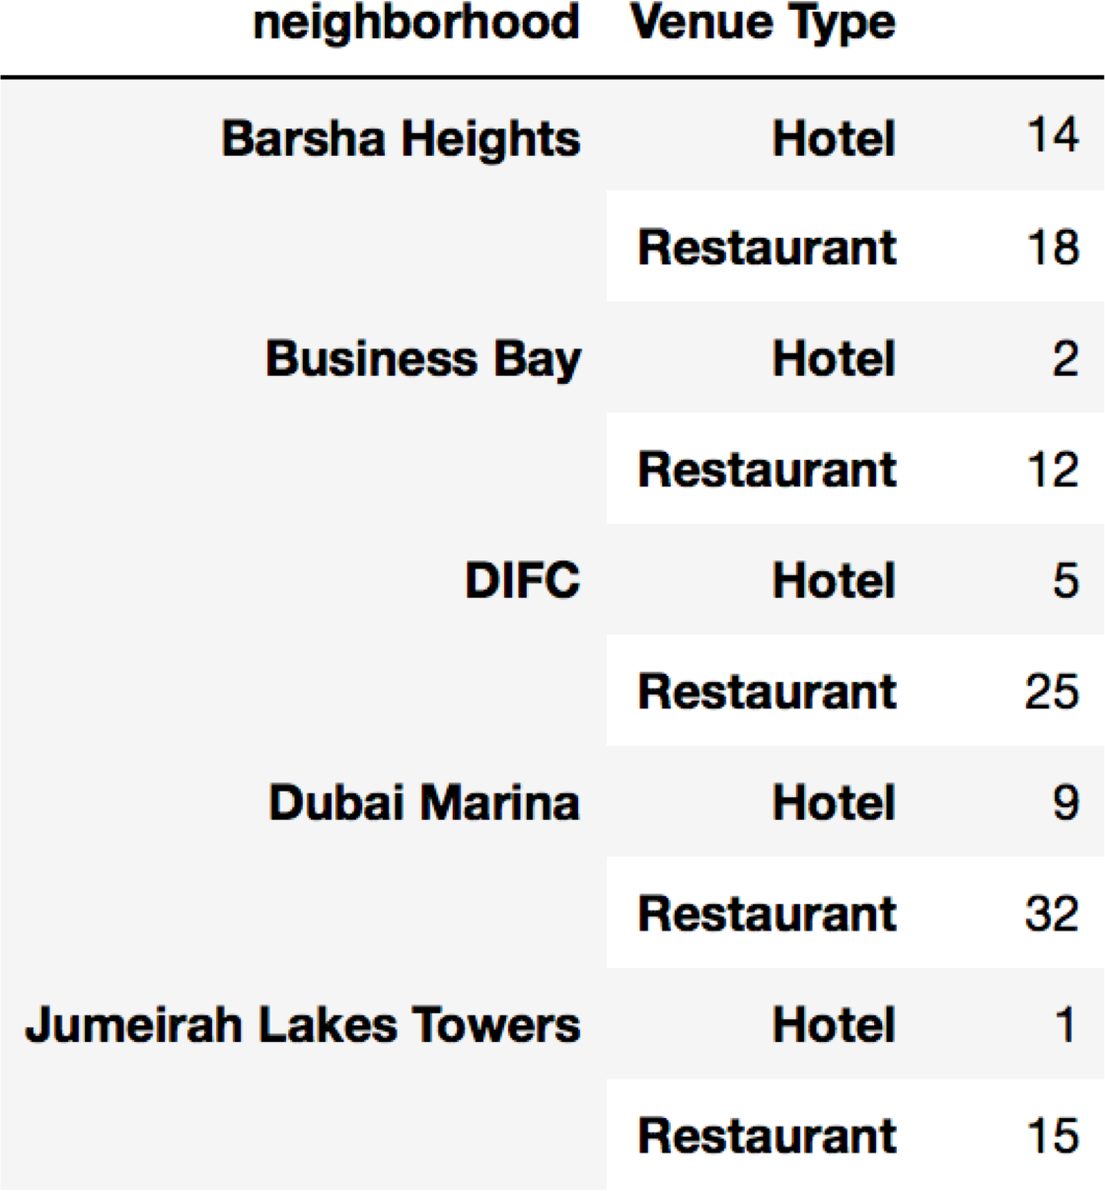
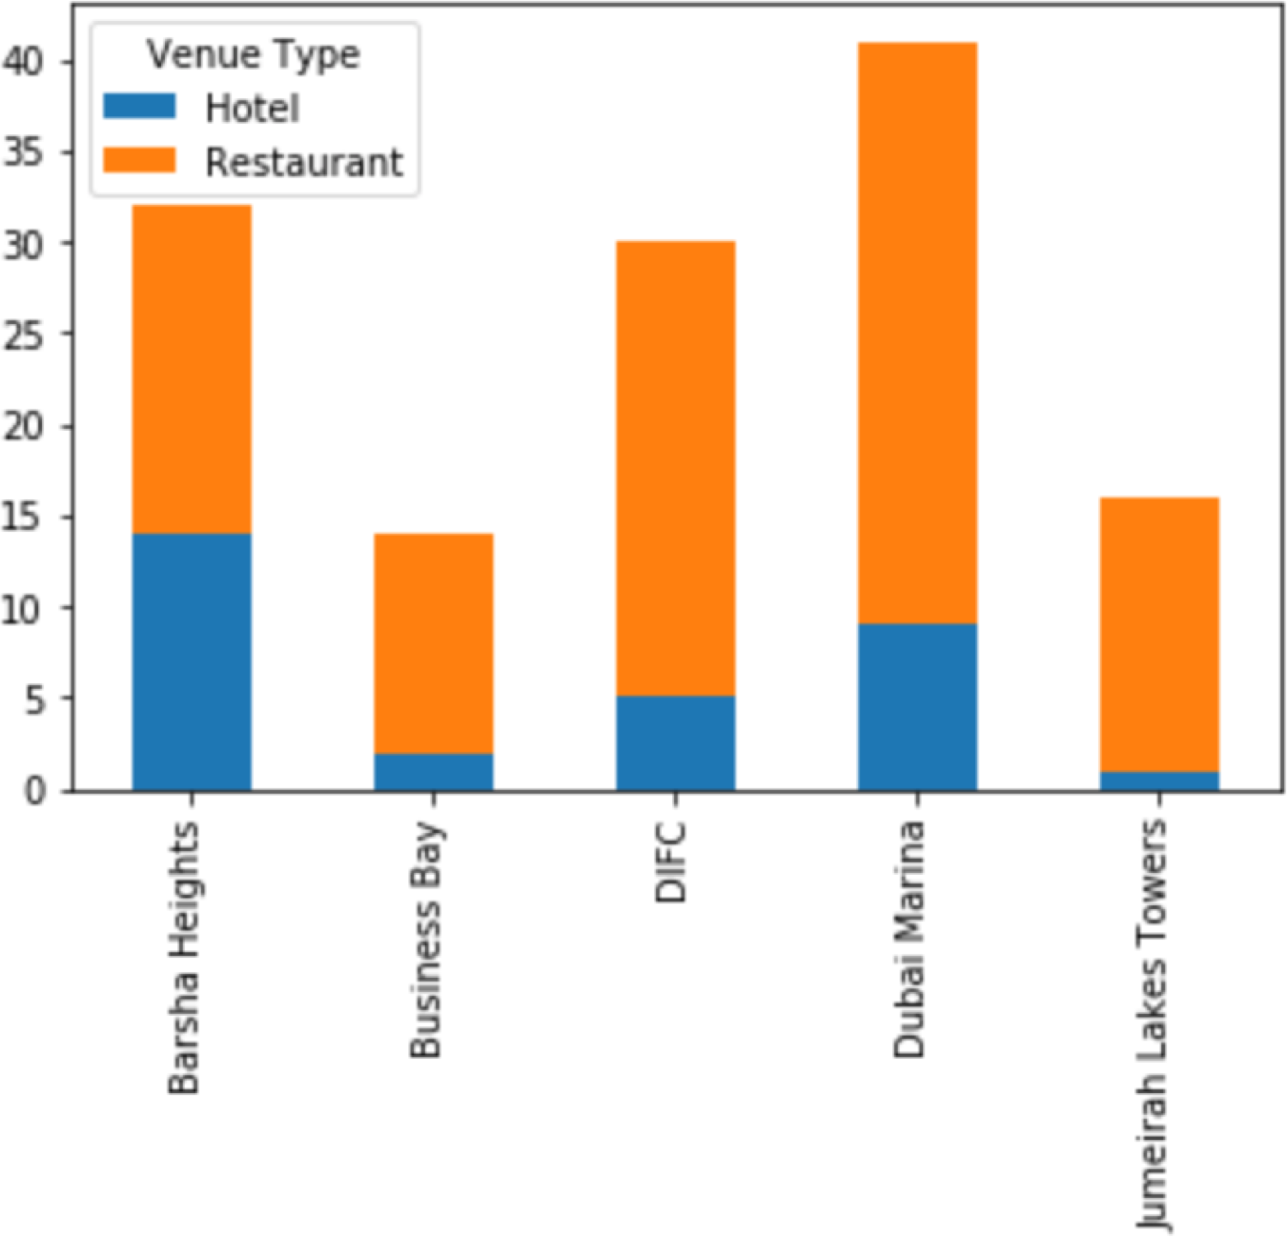

Secondary Analysis:
Elimination of neighborhoods with low traffic or high competition
Total Venue Count
‘Venue Type’ = Restaurant/Hotel
Split by Venue Type/Neighborhood
Marina = over competitive market
= preferred scenario
i.e. high volume of venues, high
volume of hotels & low volume of
restaurants

Slide 6
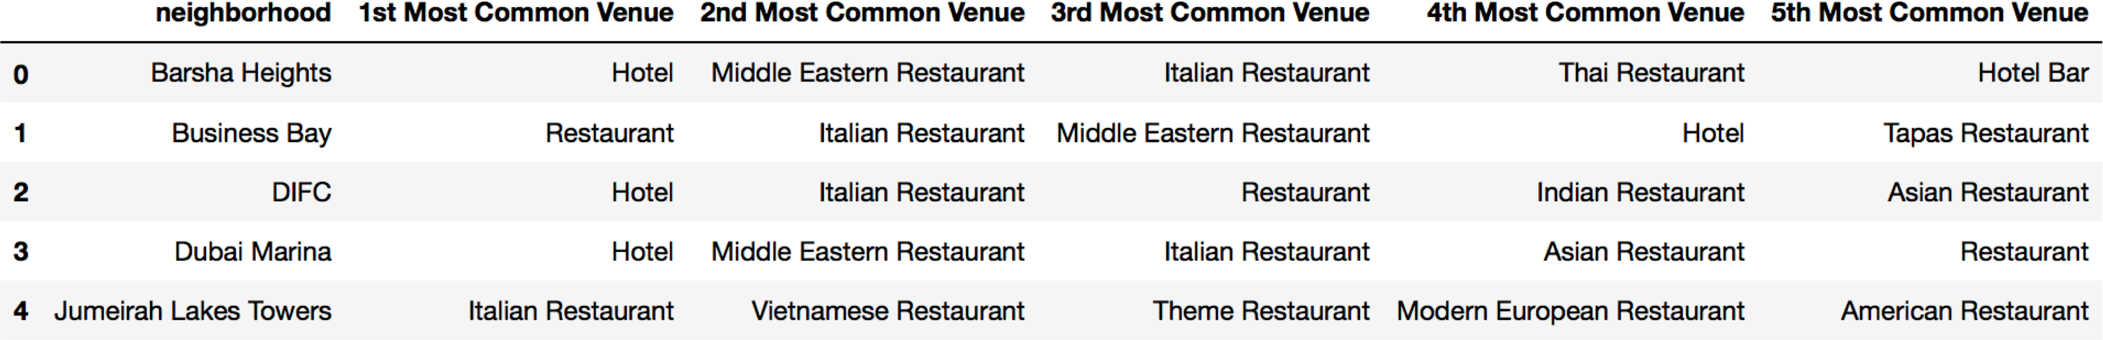
Final selection:
Benefits analysis of Barsha Heights vs. DIFC
Barsha Heights:
(+) High Volume of Hotels
(+) Low Volume or Restaurants (+) Proximity to Palm Jumeirah
(-) Lower frequency of Venues total (-) Not as well known
DIFC
(+) High Volume of Hotels
(+) Well known for Restaurants
(+) Proximity to 3 ‘High rent’ districts
(-) Increased competition
(-) Higher rent than Barsha Heights

Slide 7
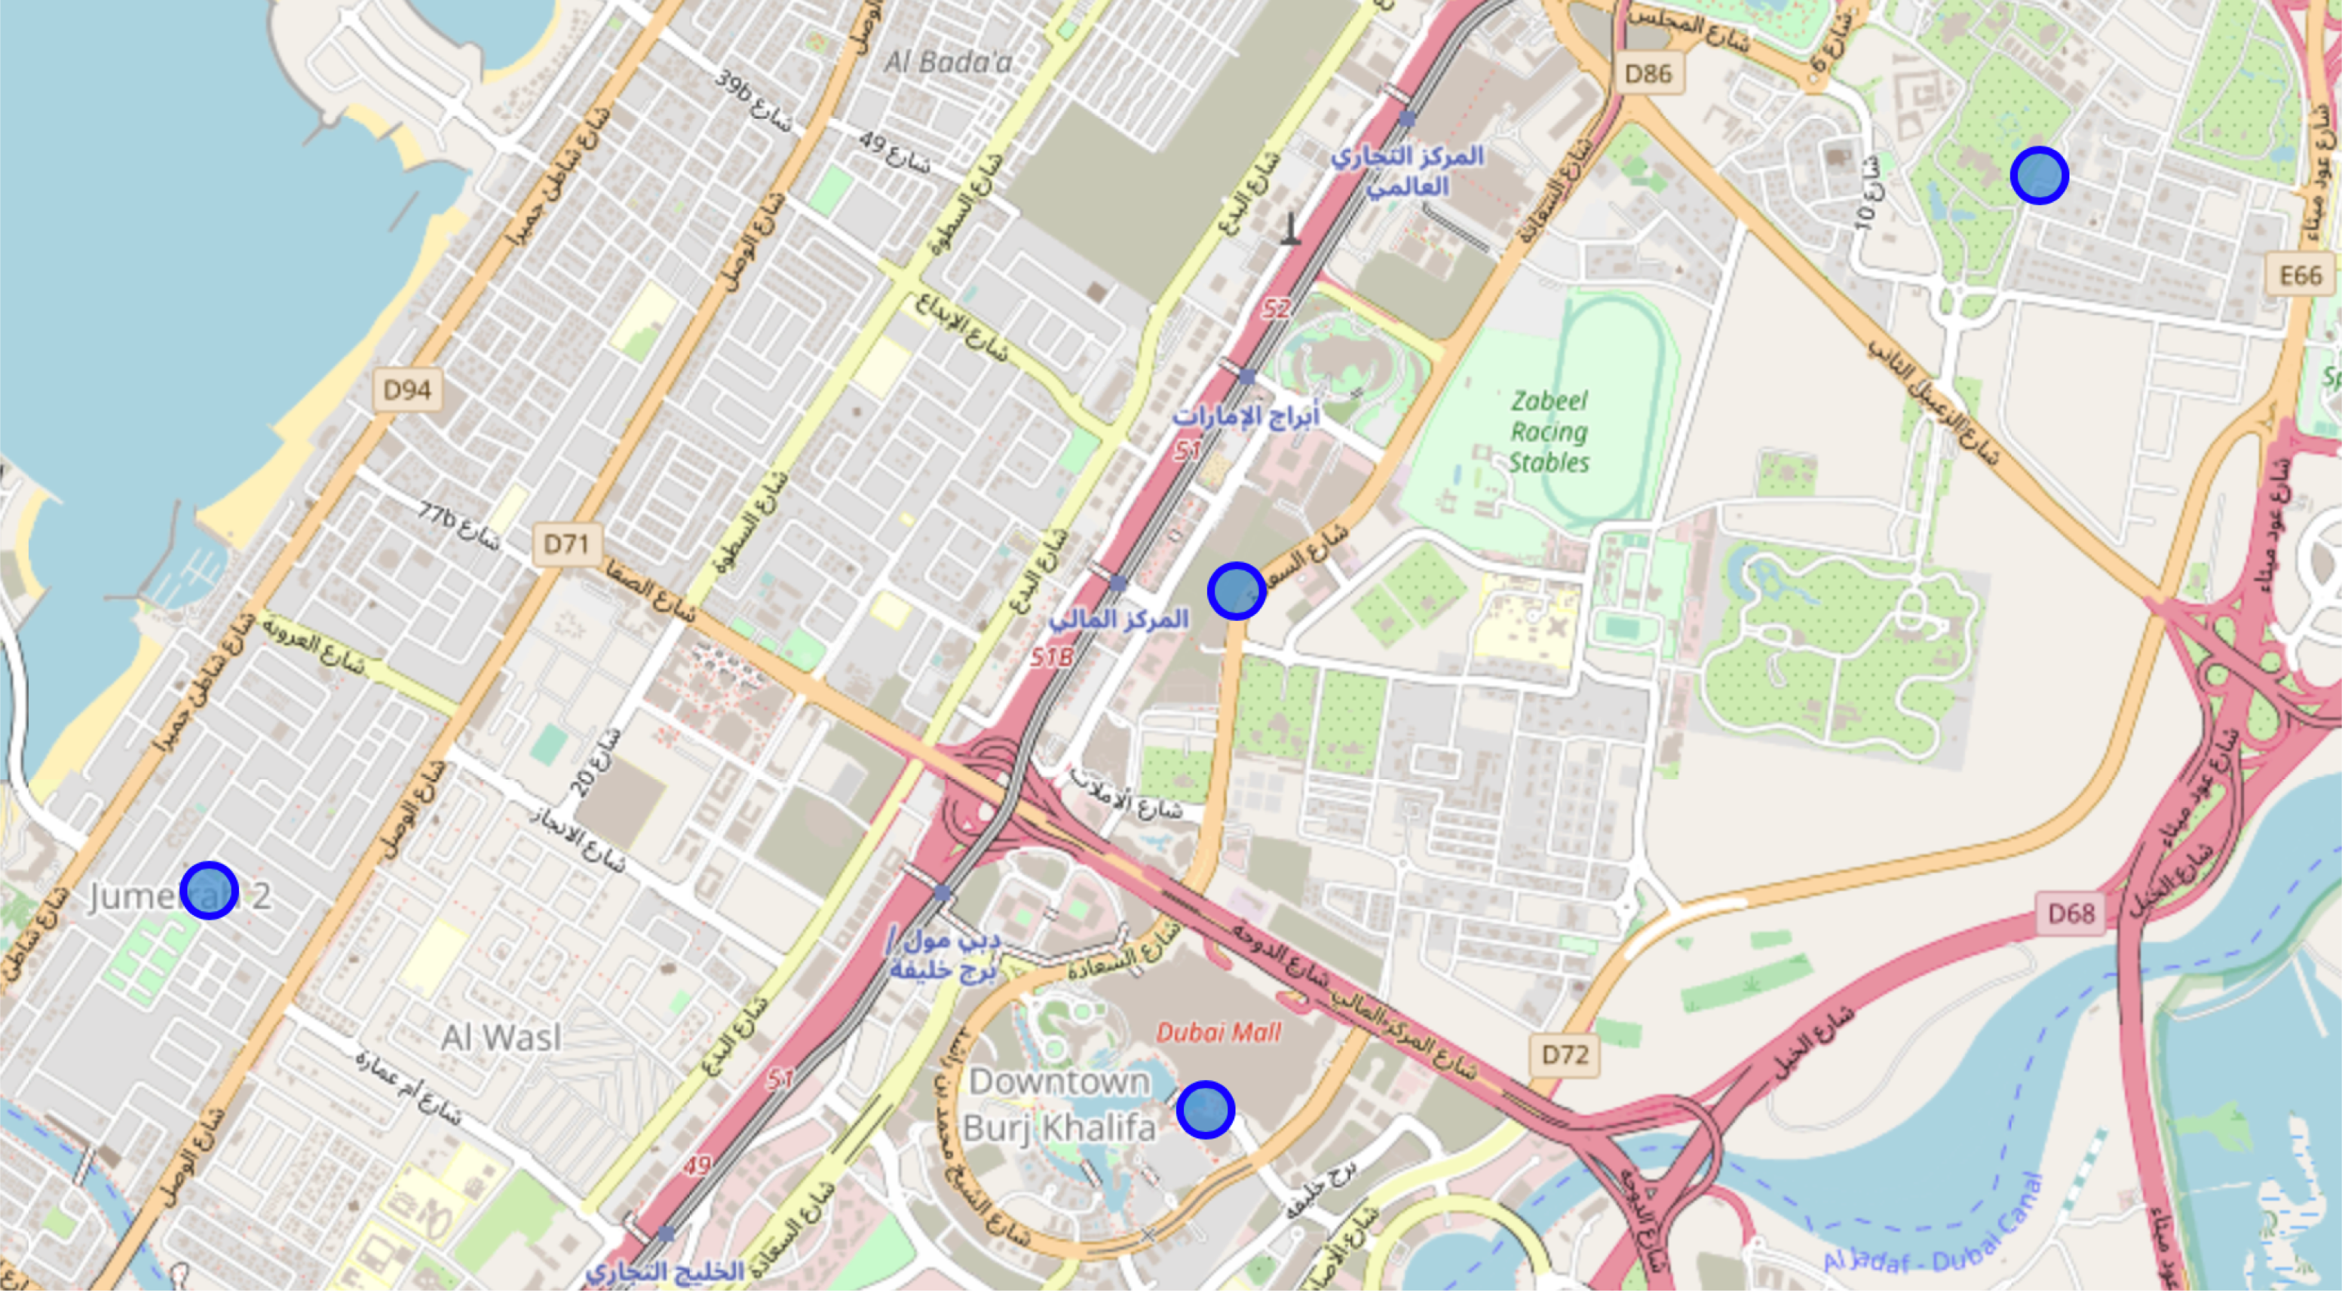
Mapping of Final Selection - DIFC
DIFC, Dubai
Zabeel
3 km
Jumeirah
3.5
km
1.5
km
DIFC
‘Downtown’

